Slide 1
CYBER HELPER
Integrated Management Service for Cyber Lecture
Team 5

Slide 2
Contents
Introduction to CYBER HELPER
Open-source projects & Open APIs and other tools/platforms/services
System Overview
Main functionalities
Recorded Demo Video
Roles of each Team Member
Expected Benefits
Q&A

Slide 3
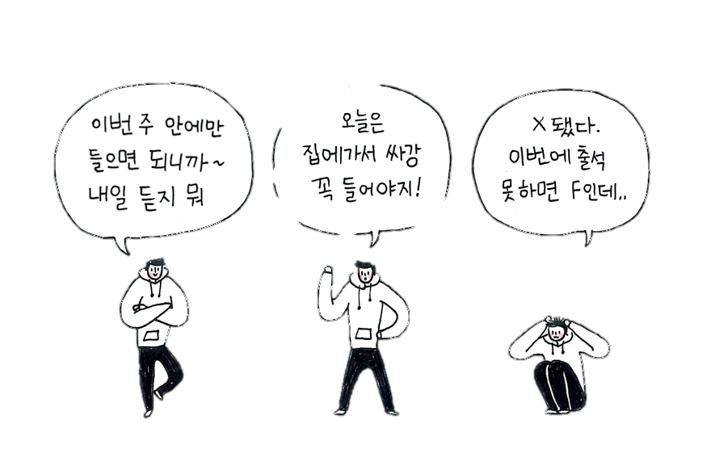
1. Introduction to CYBER HELPER
a brief description of Cyber Helper
For students who often miss classes and assignments
큰일났다.
Easy-to-use UI/UX
Optimized service for checking classes and assignments
Notes:
사이버강의의 문제점 : 그림과 같은 학생들이 많아짐 -> 수업과 과제를 놓치는 자주 놓치는 학생들을 위해서 만든 것이 우리의 서비스 (타겟사용자는 우선 이화인으로 한정)
서비스의 목표는 딱 두가지다 : 사용하기 쉽고 / 수업, 과제 체크에 최적화

Slide 4
2. Open-source projects & Open APIs and other tools/platforms/services
used for implementing Cyber Helper
Bootstrap : HTML, CSS, and JS framework
Bootsnipp : an element gallery for Bootstrap
Fullcalendar : a jQuery plugin that provides a calendar
Summernote : simple WYSIWYG Editor using Bootstrap
Data Tables : table plugin for jQuery
MySQL : an open-source relational database management system (RDBMS).
D3 : an open-source JavaScript library to create custom interactive data visualizations
ngrok : cross-platform application to expose a local development server to Internet
Notes:
Bootstrap: HTML, CSS, and JS framework for developing responsive, mobile first projects on the web
위의 오픈소스 사용한 이유 설명!

Slide 5
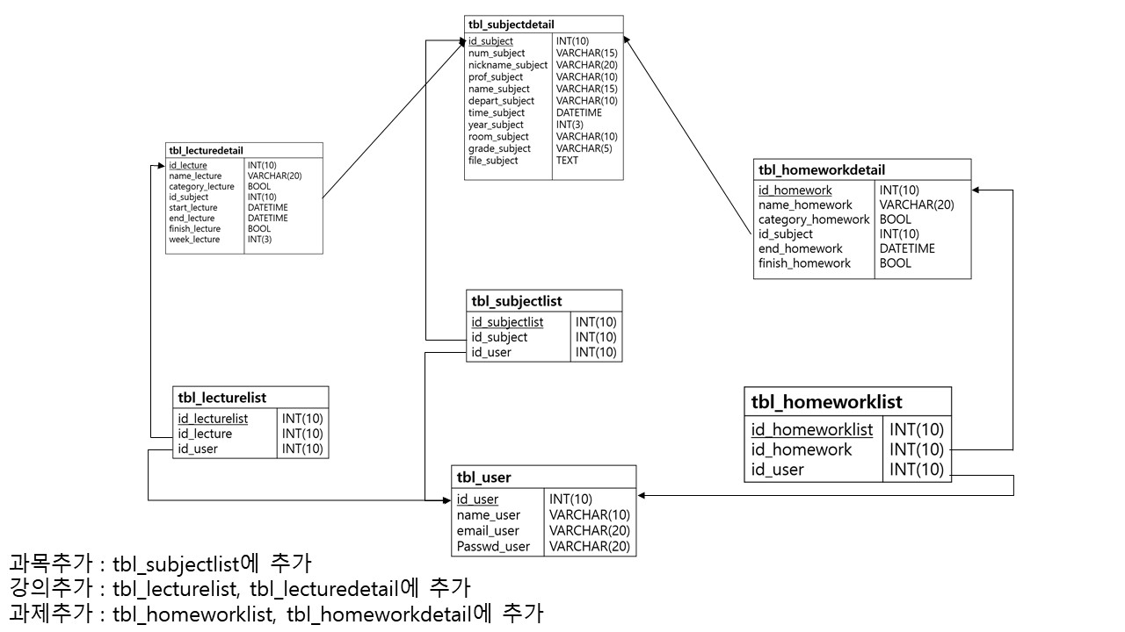






3. System Overview
how web server, database, and interface are connected
user
Internet
Server
Bootstrap
MySQL
Git

Slide 6
4. Main functionalities
detail and main purpose of Cyber Helper
Member registration
Main page, Summary table
Monthly calendar
Visualized graph
member registration
enter the main page
list round-up
to-do list / daily log
show up the list
add & modify the schedule
progress with graph

Slide 7
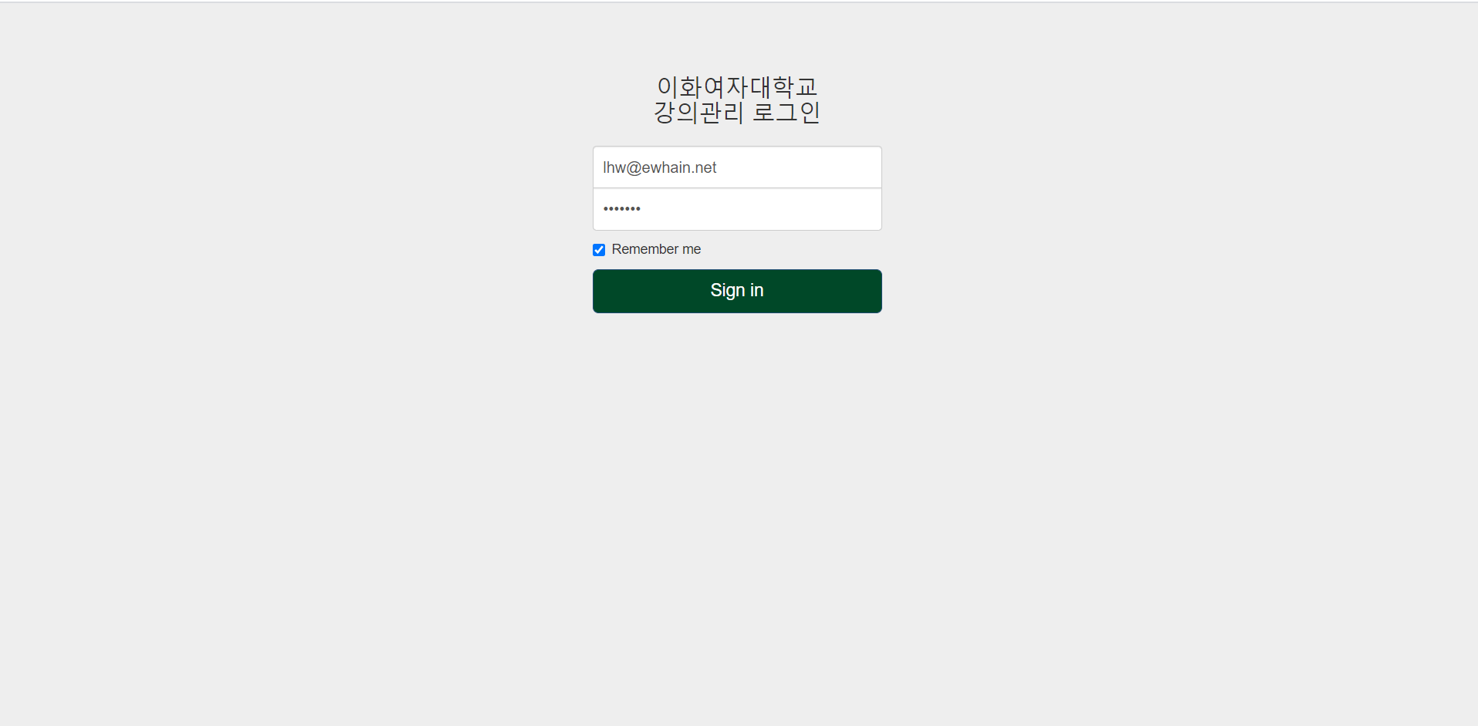
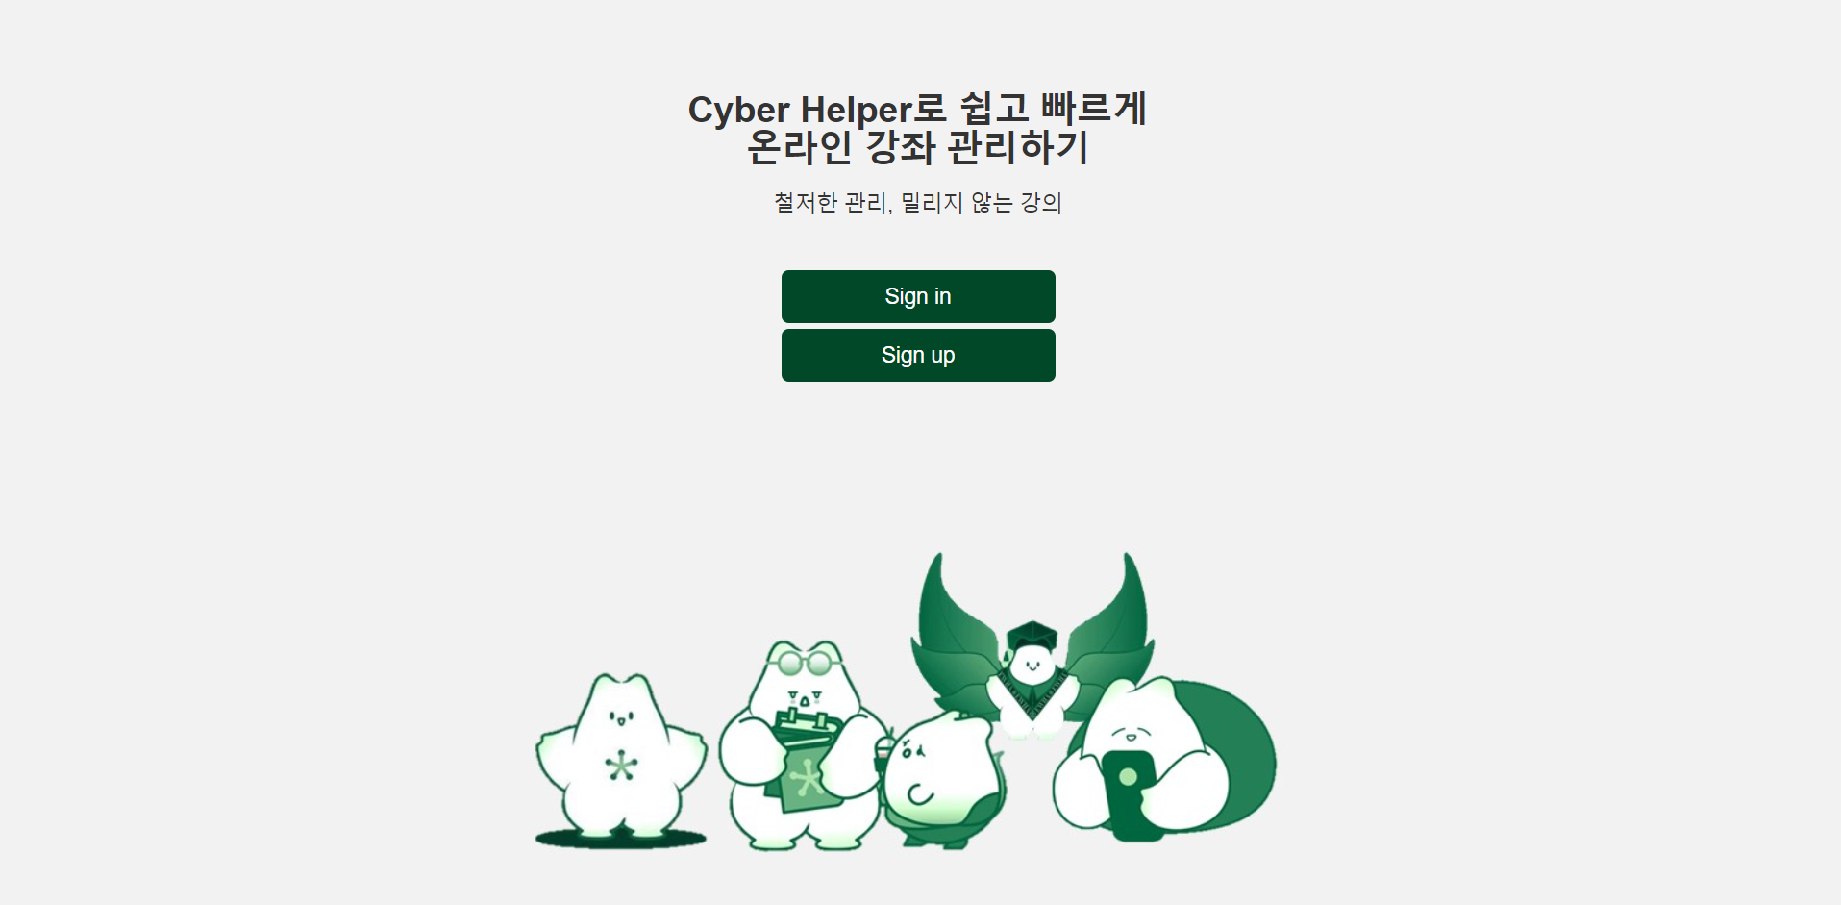
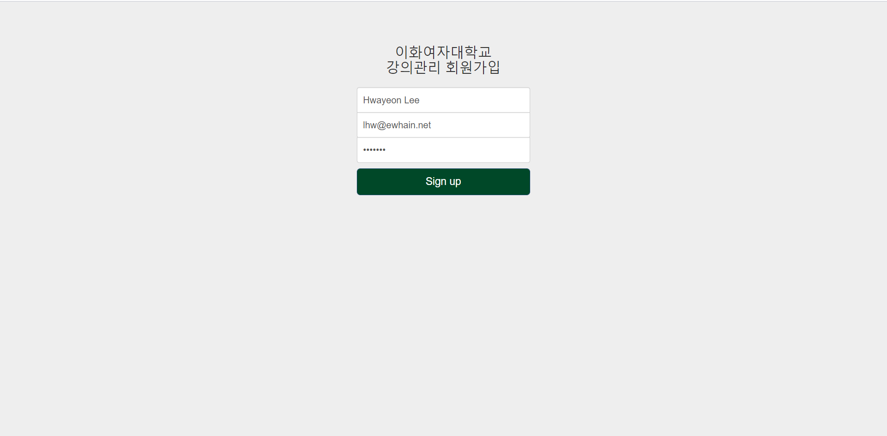
4-1. Main functionalities – Member Registration
Member Registration
<user already has an account>
enter the main page immediately
<user does not have an account>
① fill out the form
② obtain approval for membership

Slide 8
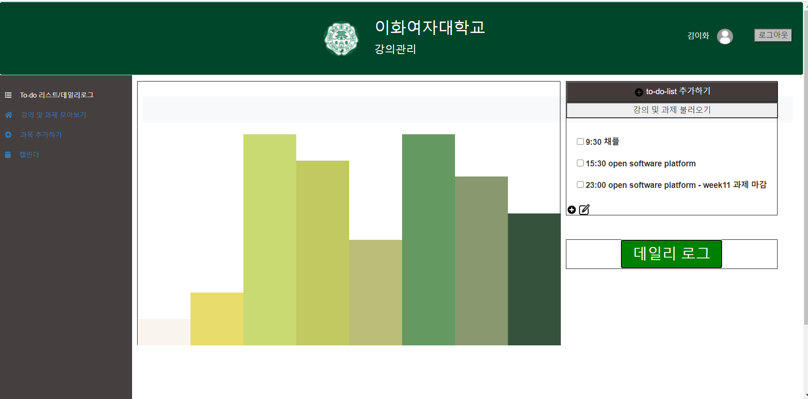
4-2. Main functionalities – Main Page
Main Page
<to-do list>
lectures and assignments
Visualized Graph
<graph>
visualize the progress of schedule
<daily log>
keep a diary

Slide 9
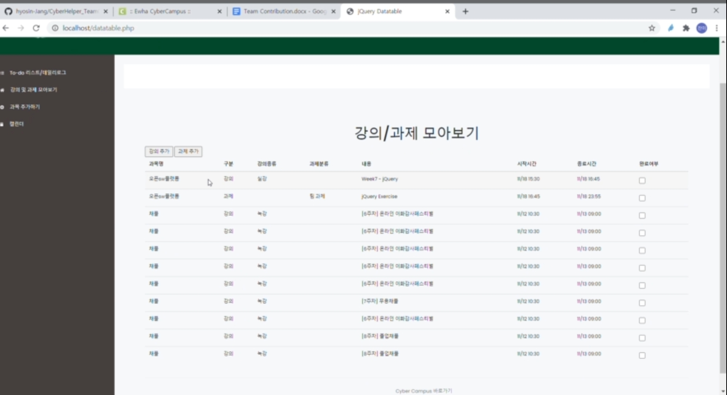
4-2. Main functionalities – Summary Table
Summary Table
<key word search>
<assignment>
list of assignments
<lecture>
list of lectures
<labeling>
Gather the lectures which have same tag

Slide 10
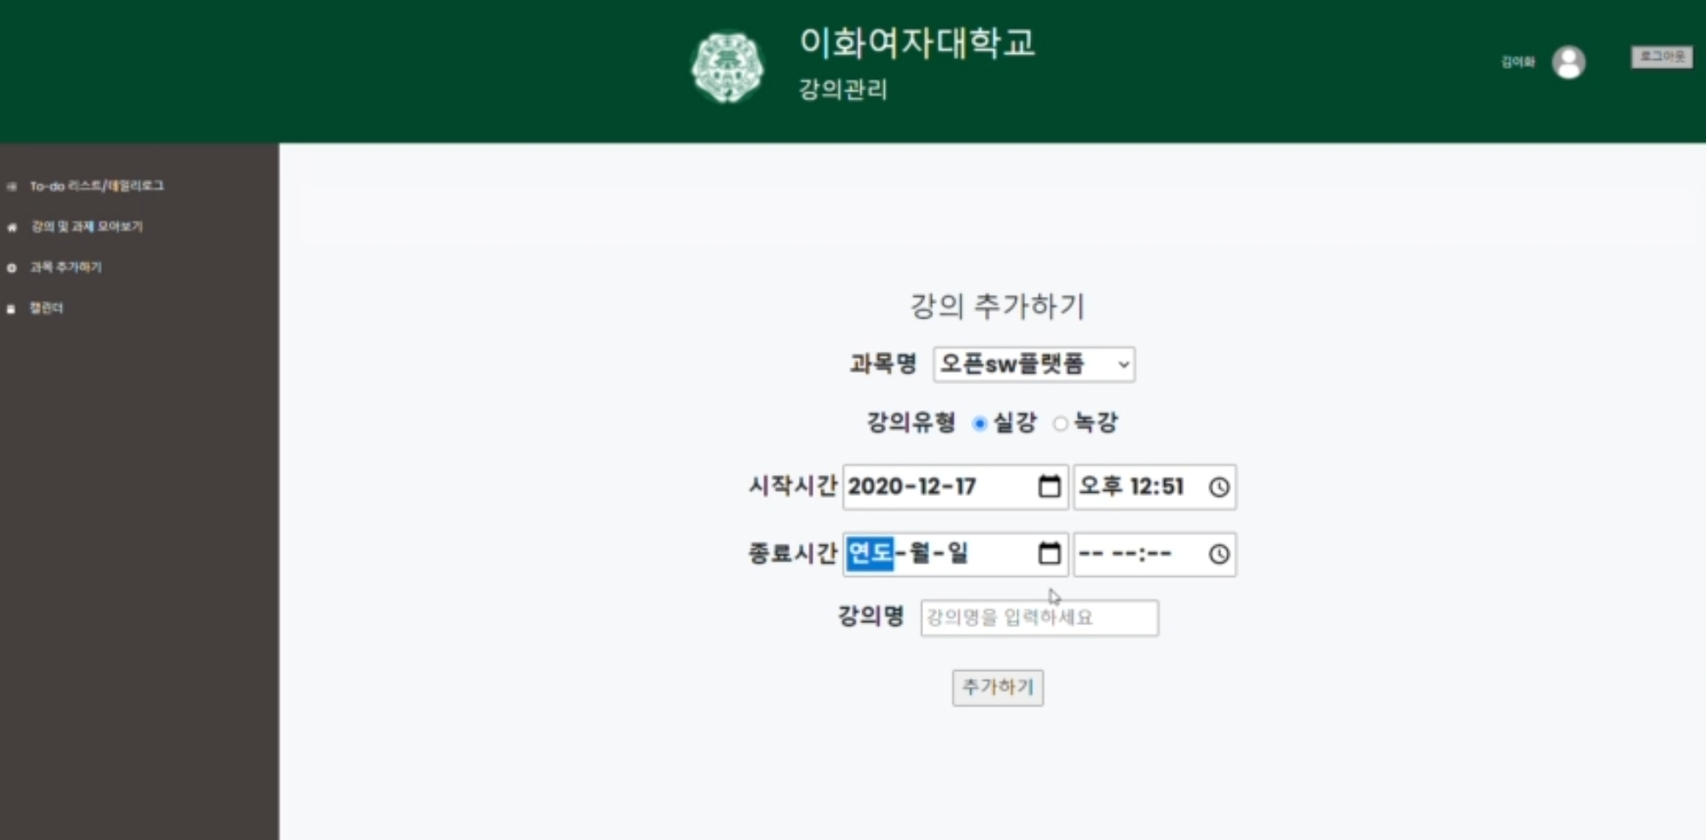

4-2. Main functionalities – Summary Table
Summary Table
add a new lecture
add a new assignment

Slide 11
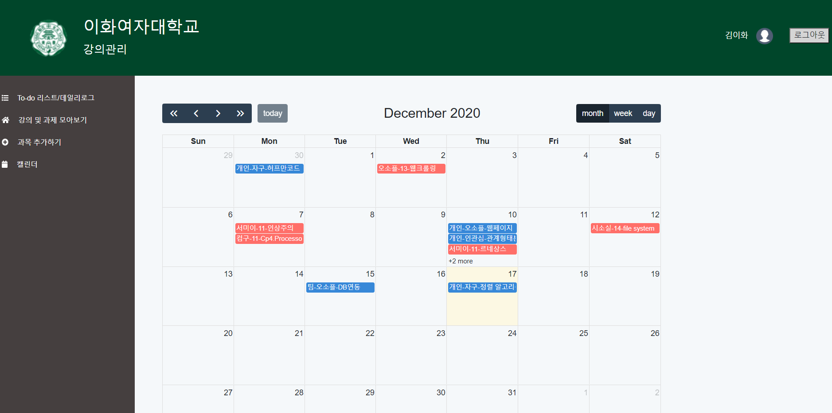
4-3. Main functionnalities – Monthly Calendar
Monthly Calendar
User moves mouse over calendar, schedule is shown in the pop-up window
number of lectures

Slide 12
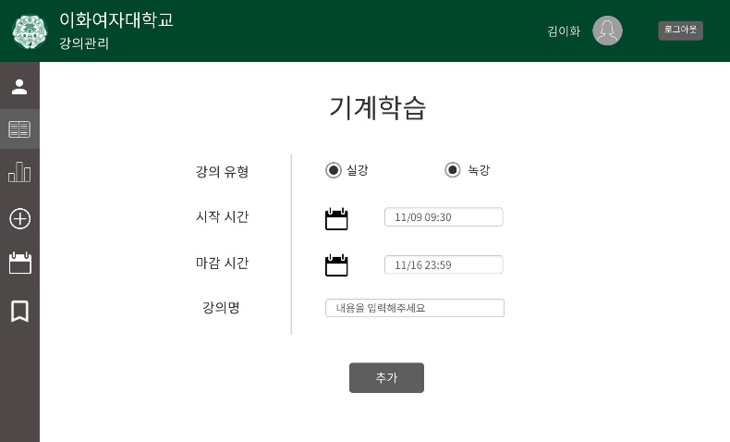
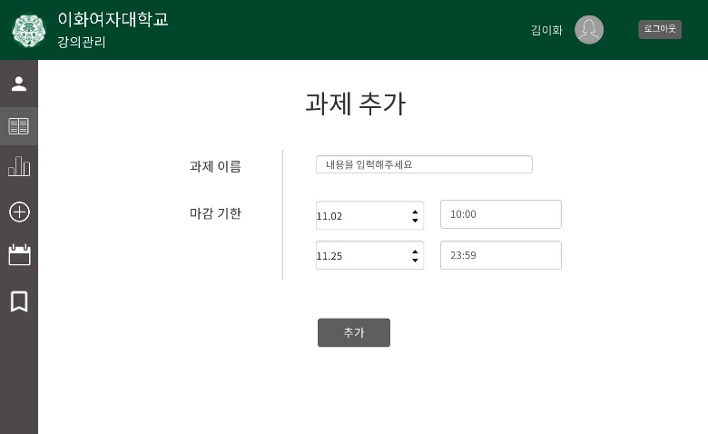
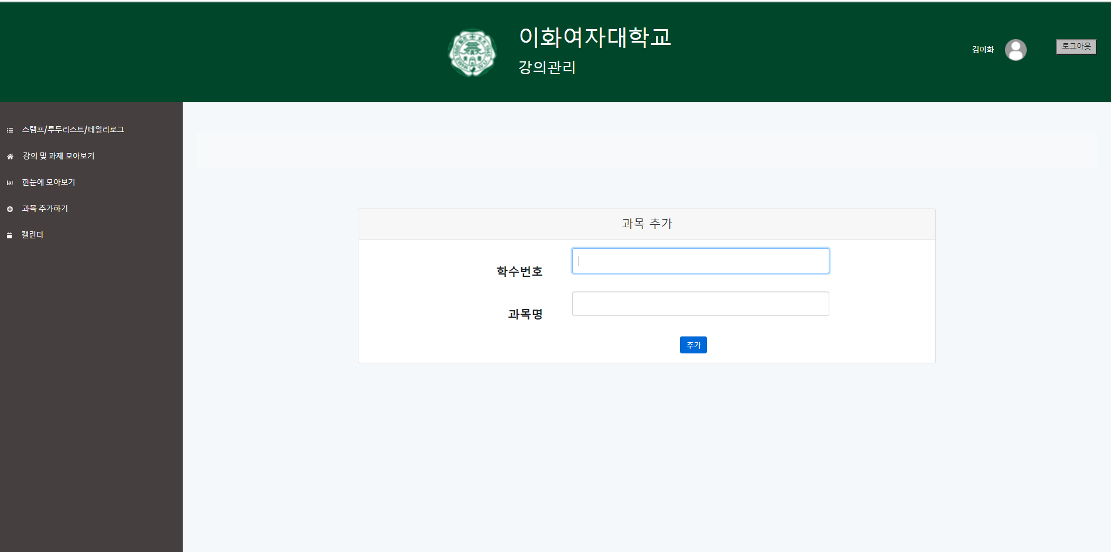
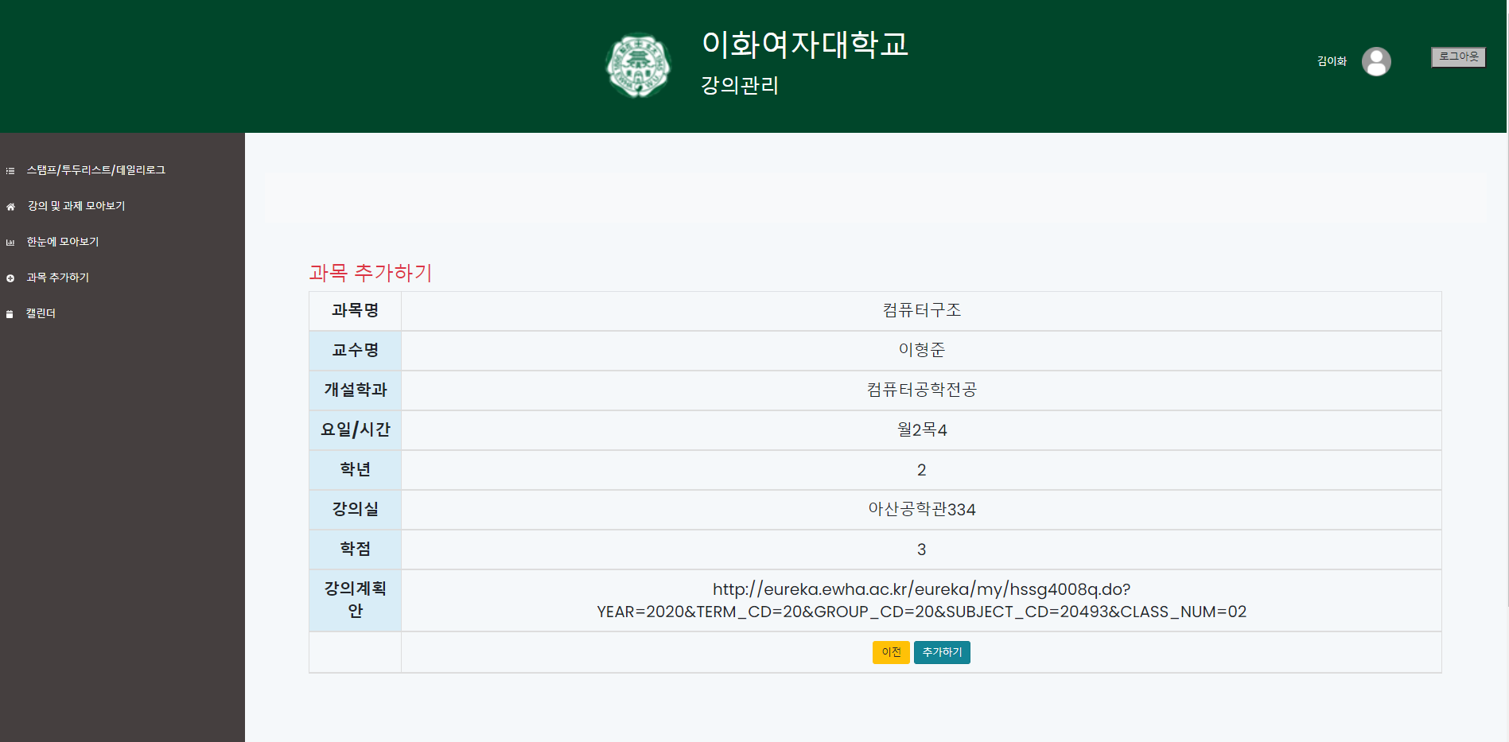
4-4. Main functionalities – Etc.
Etc.
User enters the subject number
detail information of subject

Slide 13
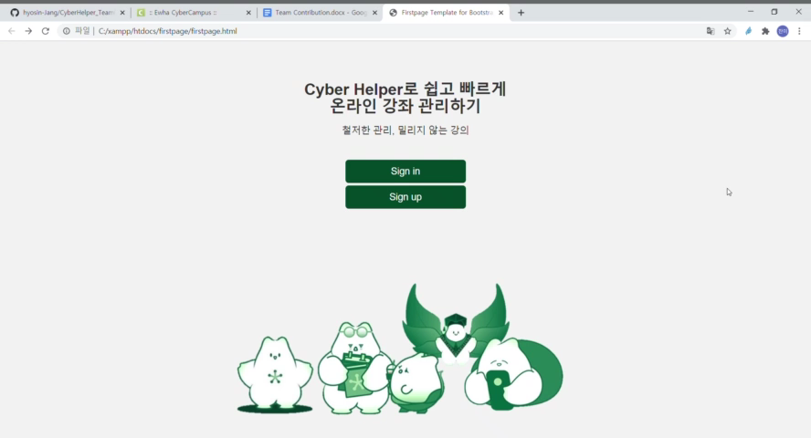
5. Recorded Demo Video
a live video of Cyber Helper

Slide 14
6. Roles of each Team Member
the contribution of each team member
MEMBER 1. 엄소정
flow chart, web crawling, css, page of adding subject and detail information
git history
MEMBER 3. 조성경
Css, page side bar, page of gathering lecture and assignment, registration
git history
MEMBER 2. 장효신
flow chart, database management, daily log page, calendar database connectivity
git history
MEMBER 4. 최찬미
page header, database management & connectivity, to-do list page
git history

Slide 15

7. Expected Benefits
effects and limitations of Cyber Helper
cyber campus with smart planner
schedule management
self-directed learning in corona era
gathering lectures & assignments
check video progress status

